Slide 1
Hospital management system
Group no.6

Slide 2
Introduction
Name: prince jakhotra
Het Padariya
Dharmik jiyani
Subject: S.I.P.2
Roll No: 92300527149
92300527254
92300527173
Topic: Hospital management system
Hospital Management System is a web-based application designed to manage and organize hospital-related activities such as patient records, doctor appointments, billing, and more. This project uses tkinter the front-end design, and Python for the back-end logic and data handling.

Slide 3
Introduction
This Hospital Management System is a web-based project developed thinter and Python.
Hospital Management System is a mini project that helps in organizing hospital-related activities digitally.
The front-end is built using tkinter, while Python is used for logic and data processing.
This system reduces paperwork and improves the overall management process in hospitals.
The system makes hospital work easier and faster.

Slide 4
Key Features
Key features:
Patient Management:
Registration form (Name, Age, Gender, Contact).
Medical history tracking (Allergies, Past Diagnoses).
Appointment Scheduling:
Real-time slot booking with doctors.
Automated reminders (email/SMS).

Slide 5
Libraries Used
Which libraries used ?
Libraries:
tkinter
We use tkinter The main Python library used for creating GUI applications. It provides tools like buttons, labels, entry boxes, windows, etc.

Slide 6
flow chart
start
Homepage
User
Selects action
Add patient
Add doctor
View patients
Show form
Show form
Read CSV
Save to csv
Save to CSV
Display table
Redirect to home
Redirect to
home
Display list
Redirect to home

Slide 7




Use case diagram
Manage room allocation
Generate reports
Manage doctor information
Manage nurse information
Manage appointments
Manage patient information

Slide 8
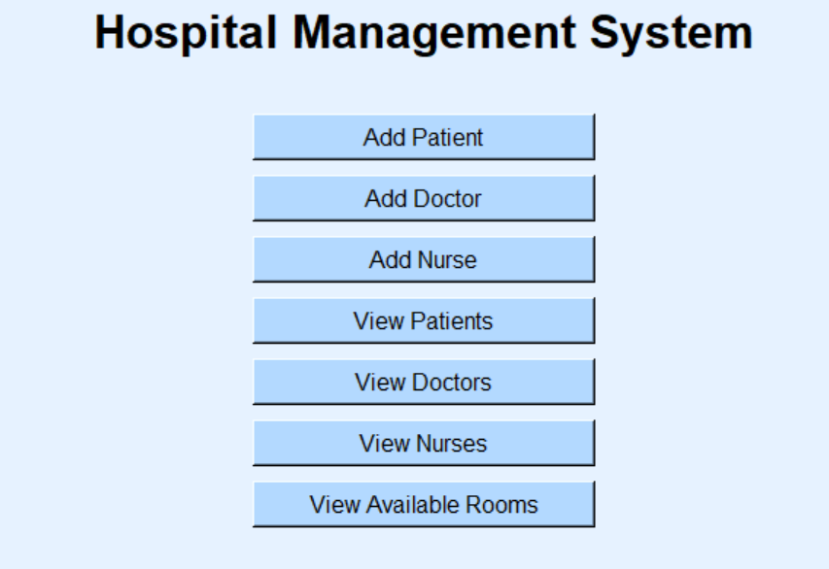

Slide 9
Home page details
This page serves as the central control panel for the Hospital Management System
The interface offers options to add new patients, doctors, and nurses to the system, as well as view existing patient records and room statuses.
Designed for efficiency, this dashboard helps medical staff manage hospital operations easyy.

Slide 10
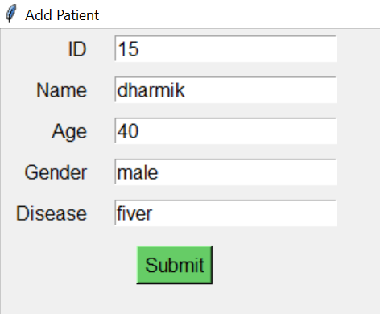
Example of project
Add patient page
This you can see this is a add patient
Fill form of our web page
And a patient add his name,age,gender
And his disease
When patient fill all this details

Slide 11
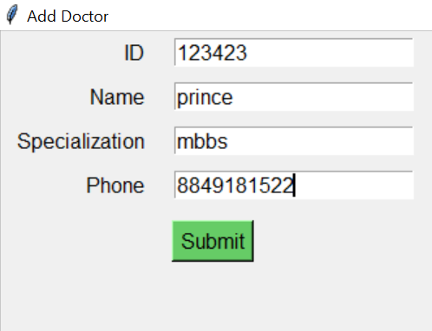
Add doctor page
The "Add Doctor" page is a form where you can enter details about a new doctor.
You need to fill in their name, age, gender, and specialty. Once done, click the "Submit" button to save the information.
It’s a simple and clear way to add doctors to your system.

Slide 12
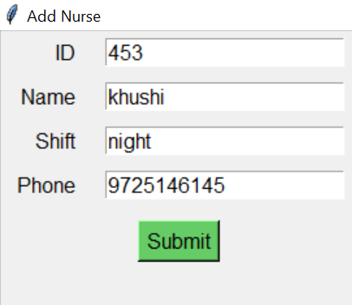
Add nurse page
The "Add Nurse" page is a simple form where you can enter a nurse's details like name, age, gender, and specialty.
After filling in the information, just click the "Submit" button to save it. This makes it quick and easy to add new nurses to your system
This helps keep your records organized and up to date.

Slide 13
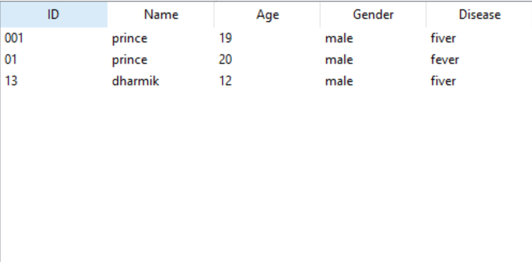
View all patients page

Slide 14
View all patients page
The "All Patients" page displays a list of patients with their details like name, age, gender, and disease.
It helps you quickly view and manage patient records.
The "All Patients" page provides a clean and organized table view of all registered patients in your system. Each row displays details:

Slide 15
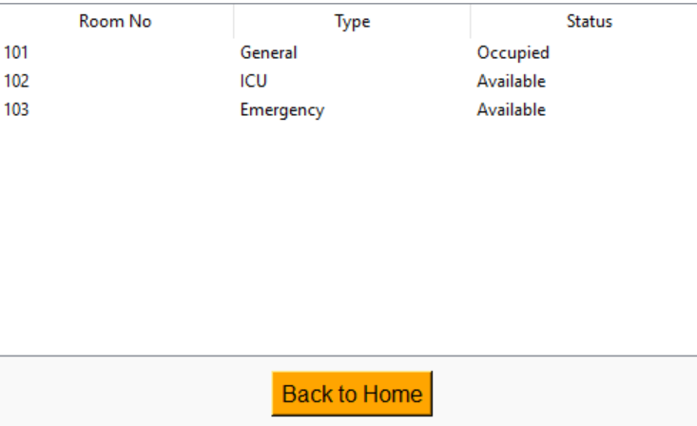
Room status page

Slide 16
Room status page
This page displays a simple room status dashboard for hospital room management.
It shows a table listing three rooms (101, 102, and 103) along with their types (ICU, General, Emergency) and current availability status.
The data indicates that Room 101 (ICU) is occupied, while Rooms 102 and 103 are available.
A "Back to Home" link suggests this is part of a larger healthcare management system.

Slide 17
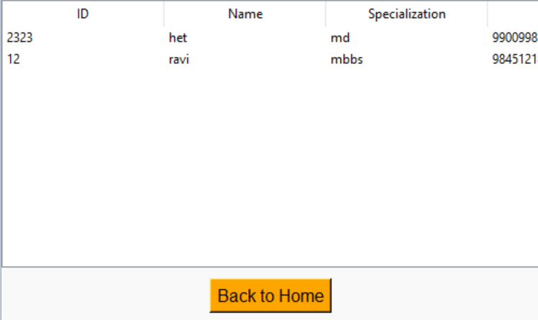
VIEW DOCTOR PAGE

Slide 18
View doctor page
This page is a part of the Hospital Management System built using Python and Tkinter. It displays a list of doctors along with their ID, name, specialization, and contact number in format.
The interface is clean and user-friendly, helping users easily view doctor details.
A "Back to Home" button is provided for smooth navigation to the main page.
This page enhances the accessibility of doctor information in the system.

Slide 19
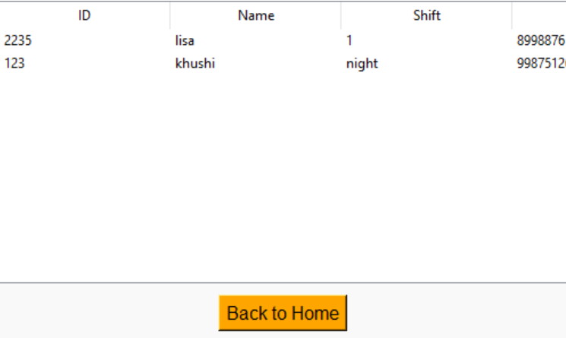
View nurses page

Slide 20
View nurses page
This page displays a list of nurses working in the hospital along with their ID, name, shift timings, and contact number.
It is developed using Python and Tkinter to provide a simple and clean graphical interface.
The table format makes it easy to view and manage nurse details.
A "Back to Home" button is added for quick navigation.
This page helps in maintaining nurse records easy within the system.

Slide 21
Conclusion
This Hospital Management System simplifies healthcare administration by efficiently managing patients, staff, and room availability. Its user-friendly design ensures quick access to critical functions, improving workflow and reducing errors. Future upgrades could expand its features, but the current system already provides a strong foundation for streamlined hospital operations.

Slide 22
Thank you

